Slide 1

ChordRipple: A Literature Review and Initial Investigation
Zuyu Chen, Samuel Missner, Yurui Wu
October 23, 2022

Slide 2
Background
For more than fifty years in contemporary western popular music, only a few chord progressions are used in many songs while most other chord progressions are rarely used.
In practice, novice composers often find it difficult to use more elaborate chords, and consciously or unconsciously falling back to familiar sets of chords.

Slide 3
ChordRipple
a creativity support tool that makes chord recommendations to composers
re-editing existing chord sequences and adding new chords
recommending diverse, adventurous but appropriate chord options to composers
enabled by a neural-network model called CHORD2VEC

Slide 4
Workflow
Retrain the embedding model using corpus of 200 Rock songs (all transposed to C) from the RollingStone Top 500 Hit
Visualize embedding when trained in the original key and compare with that of the transposed key
System and user interface design
Conduct user evaluation
Compare our results with the authors'

Slide 5

Chord Recommendation
Chord Annotation – all variations
Chord2Vec – trained embedding for recommendation
Adapted from word2vec using skip-gram algorithm.
Mapping semantically similar chords to geometrically close embedding vectors
trained from a corpus of 200 rock songs
latent dimension m = 10 and window size w = 1
Allows Novelty
Substitute rarely seen chords for a commonly used chord if they are close in the embedding space

Slide 6
Chord Recommendation
Outward Bigram Conditioning
t –> t + 1, recommending the next chord
t –> t – 1, recommending the substitution of preceding chord
Ripples Effect
Direct Query chord2vec embedding or
By inward conditioning from current context (t-1, t+1)
Move forward and backward
Smooth transitions, swap in more adventurous chords
Rework the immediate current context by a larger outer context conditioning
Ranked by transition likelihood ONLY?
Small view and neglect original structure, i.e., phrase

Slide 7
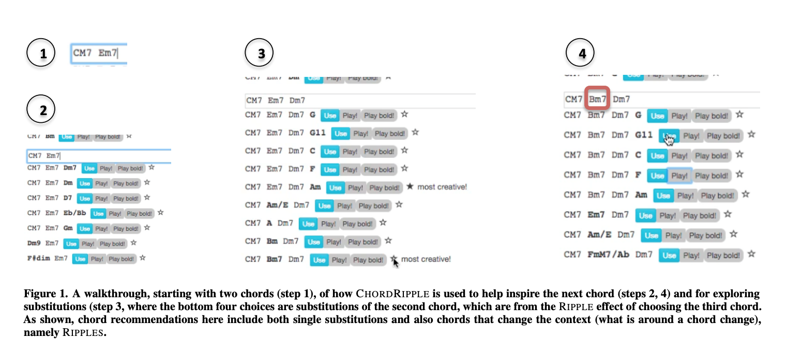
A walkthrough, starting with two chords

Slide 8
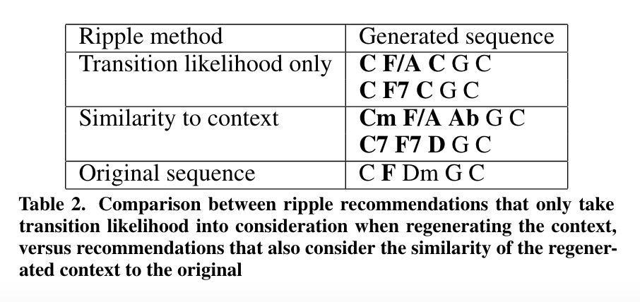
To preserve the original Structure and Coherency
Consider the similarity of the chords in the regenerated context to that of the original.
This can be achieved by maximizing both the transitional likelihood between the substitution chord, it’s regenerated immediate context and the larger original context,
And also compare the distances between the regenerated sequence and the original sequence,

Slide 9
From Word2Vec to Chord2Vec
Assumption of Analogy
The music chords distribution is close to words distribution in shape of zipf (inverse rank-frequency relation)
Like word embedding, chords appearing in a similar contexts are similar in semantics
Adopted Skip-gram algorithm
Given the current chord predicts the surrounding context chords
Good for recommending infrequent chords
Data and Exploratory Experiments
Bach chorale (92 #chords) plus Rock songs (98 #chords)
Transposition to key of C vs Original key

Slide 10
User Interface
A link to the user interface provided by the research team
Try to re-run the code
-> Invalid, need to build a new one
-> Code is from 2016 using python 2

Slide 11
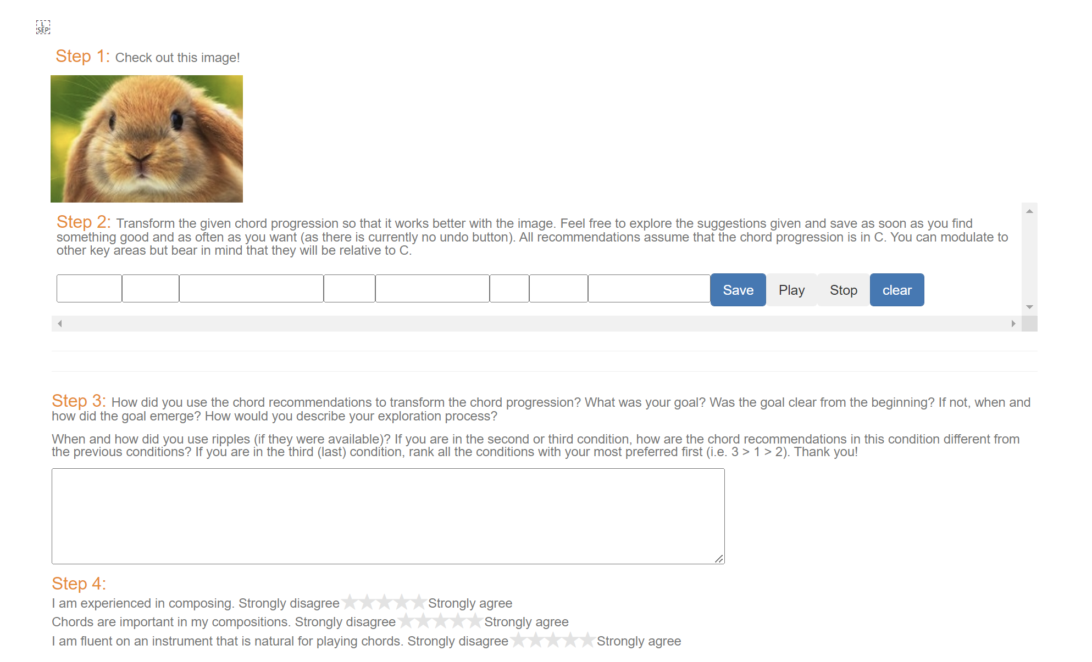
User Interface
Able to open the interface
Recommendation system not working

Slide 12
User Interface
Syntax problems
E.g., print statement without parentheses
Imported libraries version issue
libraries name changes
library no longer supported
-> get rid of the dependency

Slide 13
Evaluation
User studies were performed to measure the ease of adoption as well as the perceived usefulness of the ChordRipple system.
Two experiments were performed, one formatted as a structured observation on users and one as a controlled experiment with a list of tasks for the user to perform.
Experiments both took note of the informal reviews given by the users, as well as measured the novelty of the chord progressions that were created in part by the system.
14 paid participants, all were music university students with some composition experience each.

Slide 14
Experiment 1: Observational Study
Participants asked to bring in a composed piece ahead of time and use chord progressions from that as a starting point to form new ones in ChordRipple, as well as creating some completely new progressions for comparison.
Most participants came into ChordRipple hoping that it would help them render an idea for how they want their music to be, and put it into harmonic terms.
Reactions to the system were mixed with some users claiming that the system would output chord progressions that didn't yield satisfying music and that it was more inefficient than working out chords on their own.
The users who did embrace the system mostly liked it for its ability to produce less conventional progressions.

Slide 15
Experiment 2: Controlled Task
Participants tasked to transform an eight-chord progression to accompany a given visual prompt.
ChordRipple would transform the progression in three different ways(Singleton-Typical, Singleton-Atypical, Ripple) and the evaluation was based on how well each of these ways fit the prompt.
Measurement was based on a user satisfaction score with the connection of the chords and the prompt as well as the novelty of their selected progression.

Slide 16
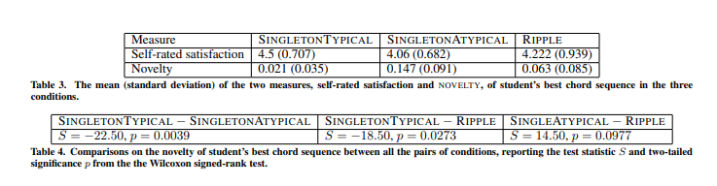
Experiment 2: Results
Ripple system yielded highest user satisfaction as well as novelty, but not significantly more than Singleton-Atypical.
Results still show higher satisfaction among users when producing more atypical/novel progressions.
Authors' claim that this implies that ChordRipple helps in allowing a composer to be more adventurous with their progressions

Slide 17
Notes On Evaluations
User study was done entirely on music students, which means that the compositional skill level of all participants is controlled to be high.
Controlled experiment has no baseline measure for user ratings nor does it compare any of the ChordRipple progressions to a progression not made in the system.

Slide 18
Links:
Paper: https://www.eecs.harvard.edu/~kgajos/papers/2016/huang16chordripple.pdf
Repository: https://github.com/czhuang/ChordRipple

